Slide 1
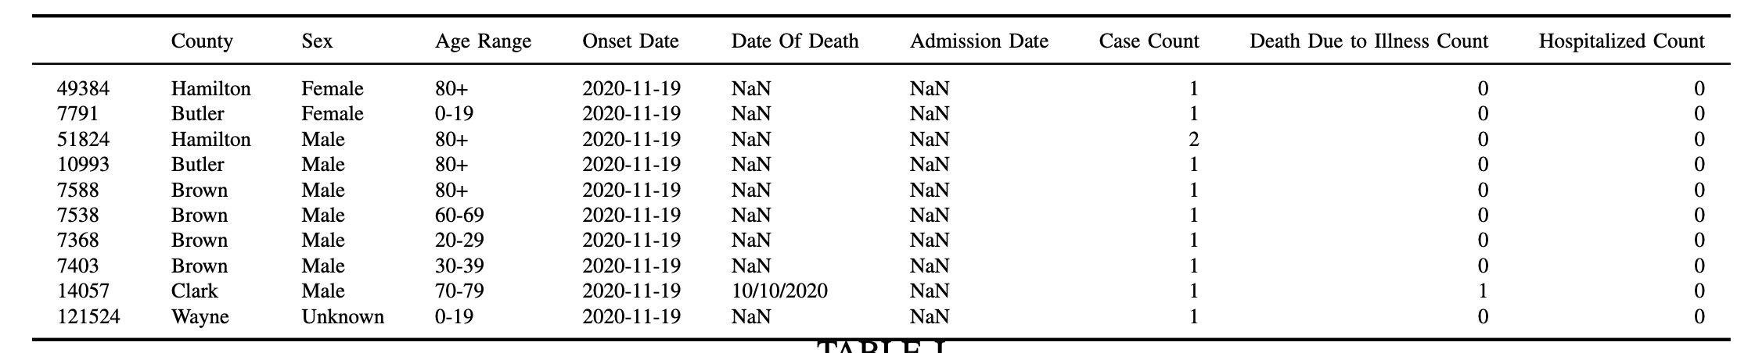
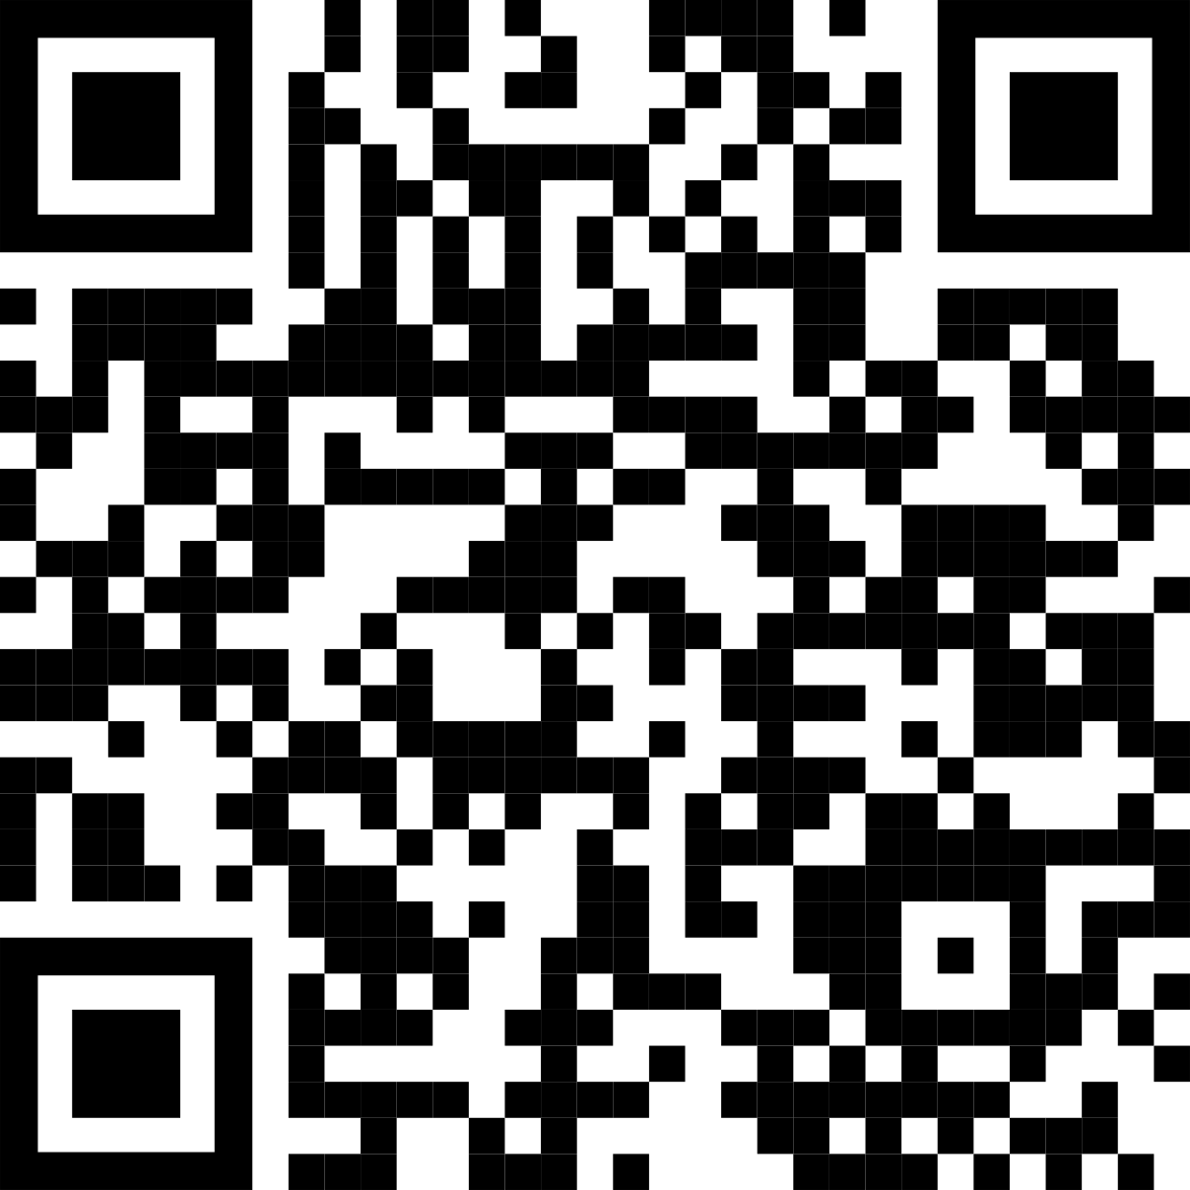
Main finding goes here, translated into plain English. Emphasize the important words.
Non-Cognitive Predictors of Student Success: A Predictive Validity Comparison Between Domestic and International Students
Non-Cognitive Predictors of Student Success: A Predictive Validity Comparison Between Domestic and International Students
COVID-19
Deaths Statistics Analysis
AMMO BAR
More detailed results:
Extract from raw data (Ohio)
Comparison with COVID tracker:
Full weekly plots:
Alexei Luchinsky, Mike Tery, Vanish Velo
INTRO
Coronavirus Disease 2019 (COVID-19) was a global pandemic as of March 2020, COVID-19 is a major issue in 2020 with wide ranging global impact for the economy, mental and physical health. Our aim is to see if we can find trends between states for COVID-19 as well as compare it against other causes of death.
METHODS
Raw COVID data is downloaded
Is compared with processed by COVID-tracker team
Is compared with other diseases
RESULTS
Our results agree with COVID tracker
Yearly picture: COVID is not dangerous
(e,g. Ohio)
Weekly stats: COVID is dangerous:
DISCUSSION
“If this result actually generalized and I didn’t have to humbly disclaim the possibility of a thousand confounds and limitations, it would imply that….”
Keep font size as high above 28+ as possible.
Keep your summary tight. Think of it like “abstract+” with key figures only.
The more content you add here, the more cognitive load you add, and the more you’ll turn people off engaging.
Less content = more readers.
Now delete this text box. ☺
Take a picture to download the full paper
Notes:
Notes:
In Powerpoint, click View > Guides
Keep text within gutter guides.
Author list: Don’t split names onto two lines (e.g., “Jimmy [break] Smith”). If that happens, use a new line, unless you need the space. Bold the first names of anybody who’s presenting in person.
Intro/methods/result: Do not drop below font size 28, but if you have extra space, jack up the font size until the space is full.
Do not use color in the sidebars except in graphs/figures. It’ll pull attention from the center and slow interpretation for passersby.

